Slide 1
Scene classification using pLSA

Slide 2
Contents
Objective
Introduction
PLSA model
Classification
Detailed steps(Flow chart)
Methodology
Progress till now
Requirements

Slide 3
Objective
Given a set of images of scenes containing multiple object categories, Our objective is to discover these objects in each image in an unsupervised manner and to use this object distribution to perform scene classification.
We use Probablilistic Latent semantic analysis followed by K-nearest neighbour classifier.
pLSA – semi -supervised
K- nearest neighbour – supervised
Investigating the classification performance under changes in visual vocabulary, number of topics learnt and develop a novel vocabulary using SIFT colour descriptors.

Slide 4
Introduction
PLSA was developed for topic discovery in text corpse,where document is represented by its word frequency.
Here , we apply it to images as documents represented by “frequency of visual words”.
We compare dense and sparse feature descriptors over a number of parameters.
Z-latent variable – topic in pLSA.

Slide 5
PLSA model
PLSA is used in discovering topics in a document using the bag of words document representation.
Here, we have “images” as documents and we discover topics as “object categories”.
E.g. grass,houses etc.
Suppose we have a collection of images D with words from a visual vocabulary W.
We summarize data in V * N co-occurence table of counts Nij= n(wi, dj ), where n(wi, dj ) denotes “frequency of word in image”.
We also have latent variable which associates unobserved class variable z belongs to Z with each observation.

Slide 6
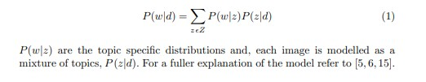
Continued
A joint probability model P(w,d) over V*N is defined by mixture:

Slide 7
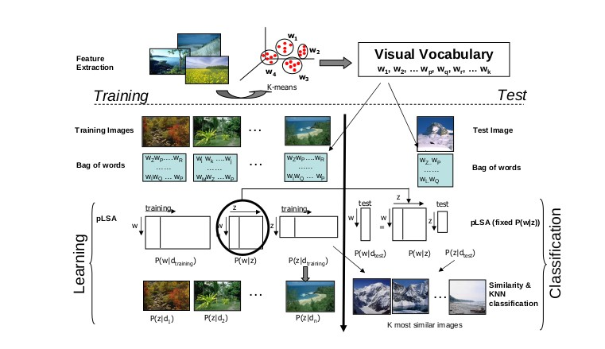
Classification
In training, topic specific distribution P(w|z) are learnt from the set of training images.
Each training image is then represented by Z-vector P(z | d) where Z is number of topics learnt.
Stage 1: Compute P(z|dtest )
Classification of test images
a KNN scheme.

Slide 8
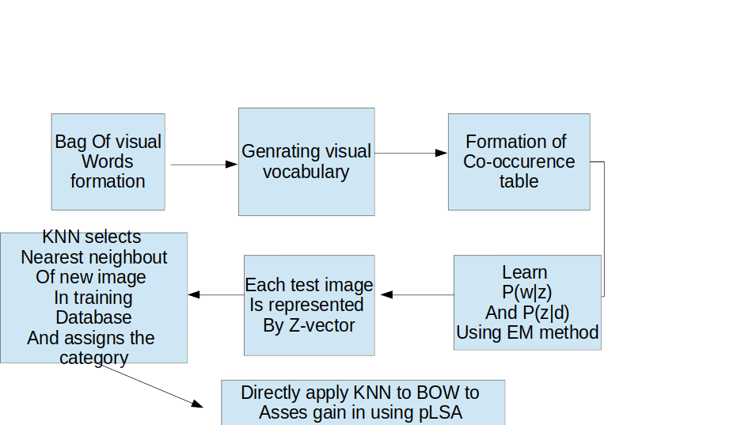

Slide 9
Methodology
Assign each test image to one of a number of categories.
Performance is measured using Confusion Table.
Overall performance rates are measured by average value of the diagonal entries of confusion table.
Vocabulary of visual words is learnt from about 30 random training images of each category.

Slide 10
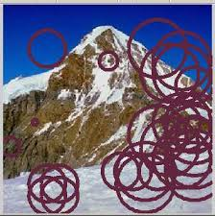
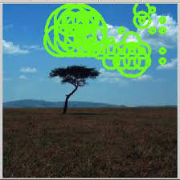
SIFT

Slide 11
Progress till now
Step 1: Collected OT dataset(image set) (8 labels)from http://cvcl.mit.edu.
Step 2: Applied SIFT and collected keypoints and descriptors.(sift_kmeans())
Step 3: Clustering using K means. (cluster size 100,200 300 400 500-MAX accuracy: 63% for cluster size 100 knn-13) (MiniBatchKmeans()) and saved it into file for reuse in testing.
Step 4: Prepared Visual word vocabulary using BOVW technique.(saving into histogram[])
Step 5 : repeated from step 1 to step 4 for test images as well
Step 6: Matching hist[] of train and hist[] of test and obtained matching percentage.

